Slide 1
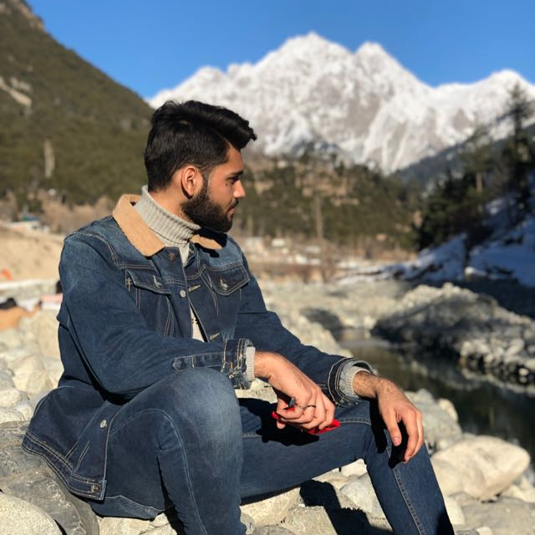
Afnan Nadeem
The Story Of My Life
ERP: 23970

Slide 2

A little about me
My name is Afnan Nadeem
I was born in Karachi and I have lived all over Pakistan since my father is a doctor in Pakistan Army.
I’m currently pursuing Bachelors in Business Administration (BBA) at Institute of Business Administration (IBA) Karachi

Slide 3
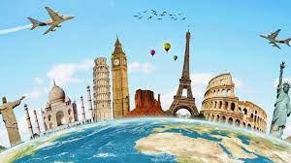
Life Goals
I plan on doing Masters in Business Administration (MBA) .
Starting my own business is also one of my life goals.
Travelling is one of my favorite activities so I plan on travelling the world

Slide 4
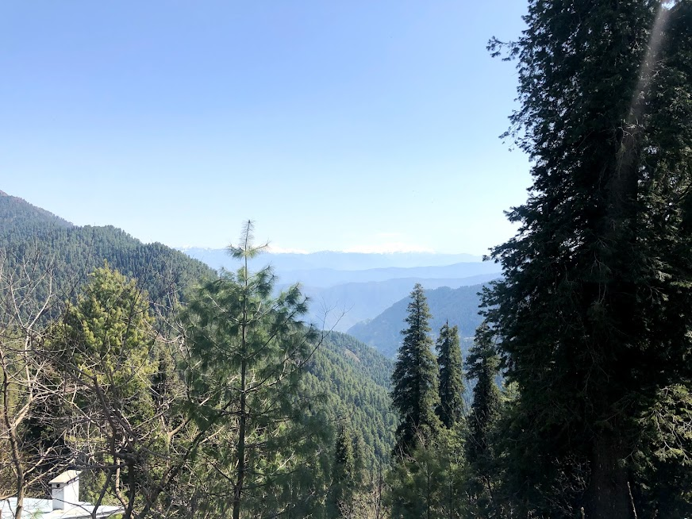
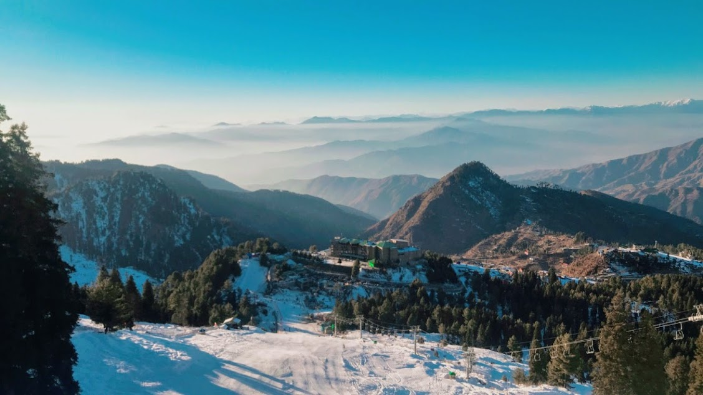
Hobbies
Nathia Gali, KPK
I’m a big fan of gaming
My favorite hobby is travelling which I’ve done a lot of.
Malam Jabba, KPK

Slide 5


Hobbies
I play a lot of sports, I’m good at Football, Cricket, Table Tennis, Badminton, Squash, Swimming and many more.
I love watching TV shows and movies on Netflix, my current favorite is Brooklyn 99

Slide 6
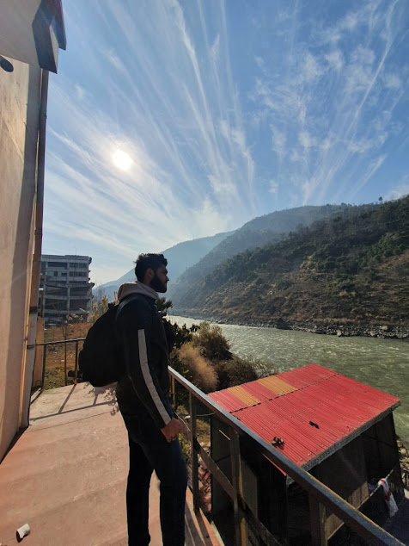

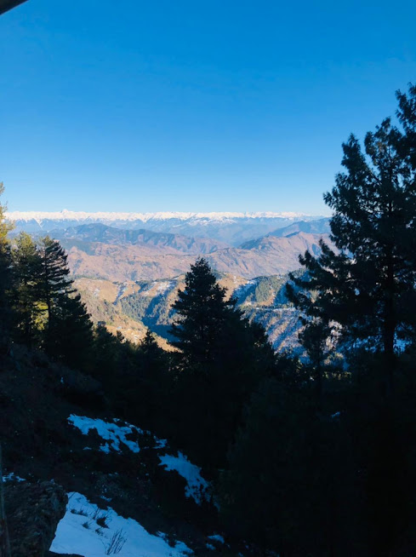
Photography
I’m a big fan of photography and videography, the following is a time-lapse video of a jeep ride to Shogran, KPK, during winter, I love winter and adventures as it’s a new challenge every time and I enjoy it.

Slide 7
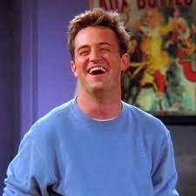
About my personality
Hardworking
Friendly
Selfless
Honest
Trustworthy
As sarcastic as Chandler Bing

Slide 8

What I look for in others
Loyalty
Honesty
Humbleness
Getting me food
Laughing at my lame jokes
Optimisitic
Mutual liking for F.R.I.E.N.D.S

Slide 9
Reflecting on ICA
ICA has been a very enjoyable course with Sir Waseem Arain and I have learnt a lot of new things that will help me in my upcoming professional life, such as MS Word, MS Excel, MS Powerpoint, Git and it has helped us improve our typing skills, it has been a very productive course overall and I have enjoyed it a lot.

Slide 10
That’s all about me
This little presentation kind of sums me up, I’m unique in my own ways as I’ve shown and I hope you enjoyed this little piece of what I am, that’s all from me.
Afnan Nadeem,
Signing off ☺

Slide 11


